Slide 1
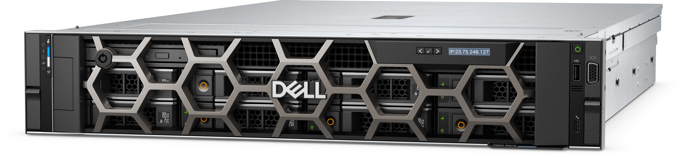





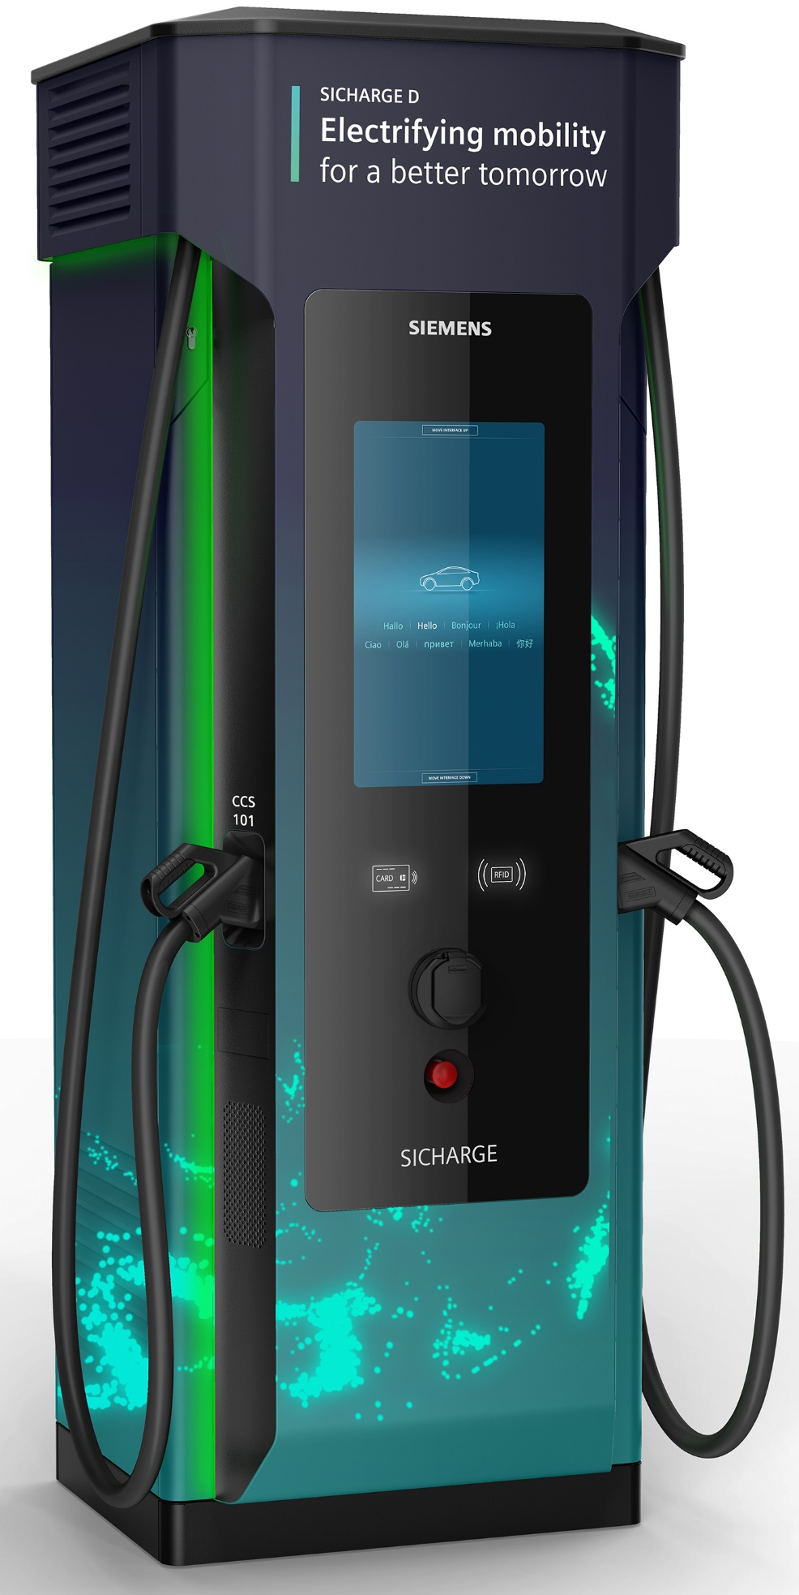
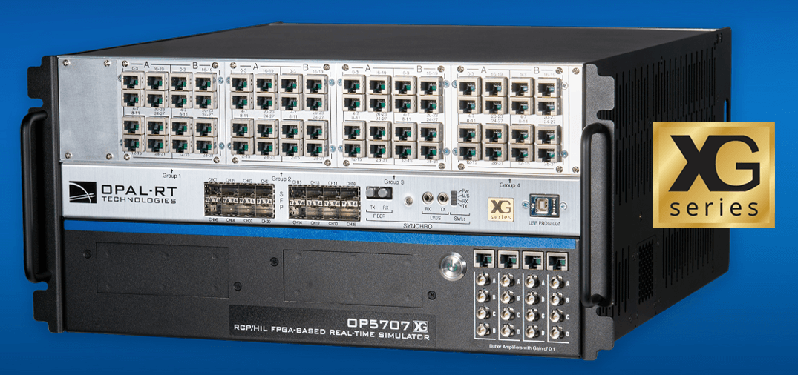
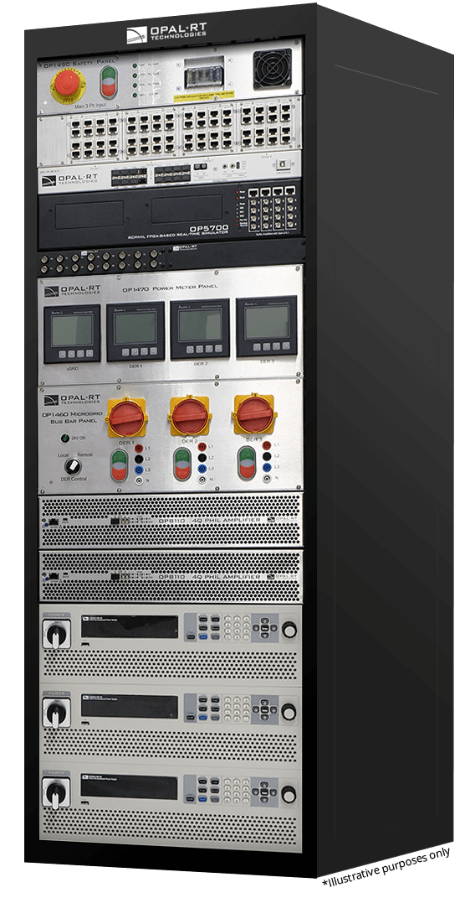
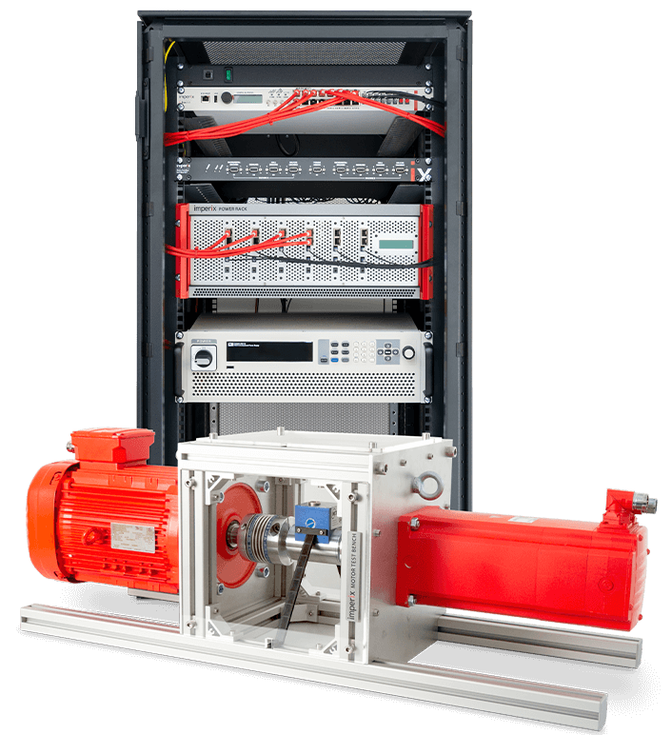
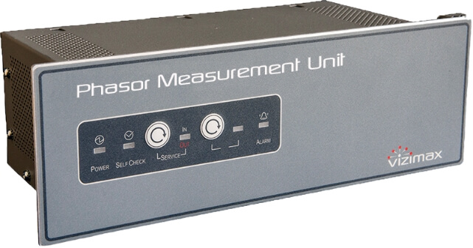
remote access
Modeling and Data Analytics Server
ethernet
SIEMENS eMobility DC Fast-Charger
Hardware
SICHARGE UC 150 power control cabinet 150kW/480V
SICHARGE UC 150kW dispenser
Capability
$\sim$100–200 miles per 30 minutes of charging
OPAL-RT High-End Performance Real-Time Simulator
Hardware
OP5707XG real-time simulator
Intel Xeon 8 cores, 3.8 GHz
Xilinx Virtex 7 485T
Real-time simulation capability
Full scale transmission grid
ethernet
optical fiber
optical fiber
Imperix Rapid Control Prototyping for Power Electronics Applications
OPAL-RT Microgrid PHIL Test Bench
Hardware
OP4610XG real-time simulator
5kW 3-phase 4-quadrant PHIL amplifier
6kW 500V DC power supply
Hardware-in-the-loop simulation example
66kV AC-grid
145kW 3-phase distribution load
480V 1MWh battery energy storage system
480V 12kVA photovoltaic generation system
575V 10kVA wind turbine generation system
600V 70kVA diesel generation system
Hardware
4 kW squirrel cage induction machine
4 kW permanent magnet synchronous machine
800V/38A SiC half-bridge modules
Bidirectional torque sensor
2x PT1000 temperature sensors
Resolver (position sensor)
Real-time simulation capability
Control hardware-in-the-loop (C-HIL)
Grid-following and grid-forming control schemes
Wind turbine emulation
ethernet
Vizimax PMU
Hardware
10x digital inputs
6x high-current digital outputs
Measurements
Synchrophasor up to 240 frames per second
Sampled values reporting with IEC 61850-9-2LE and IEC 61869-9

Slide 2
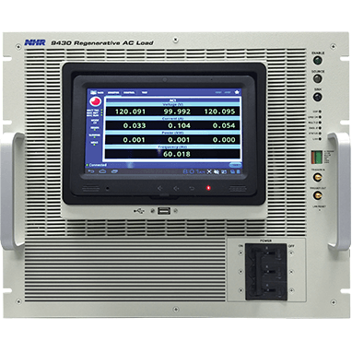
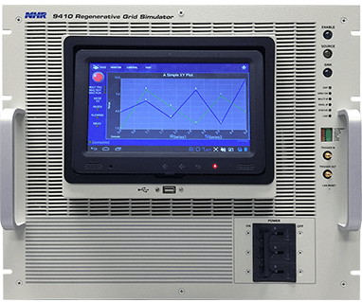
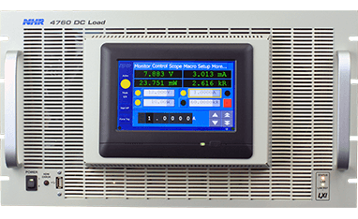
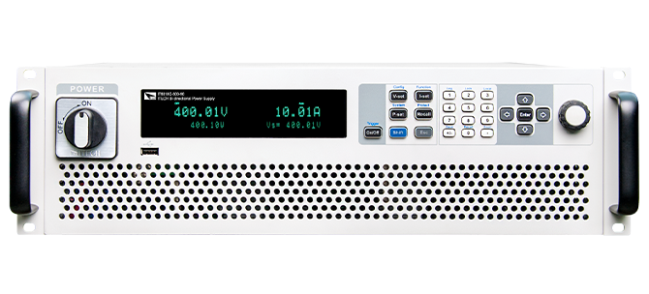
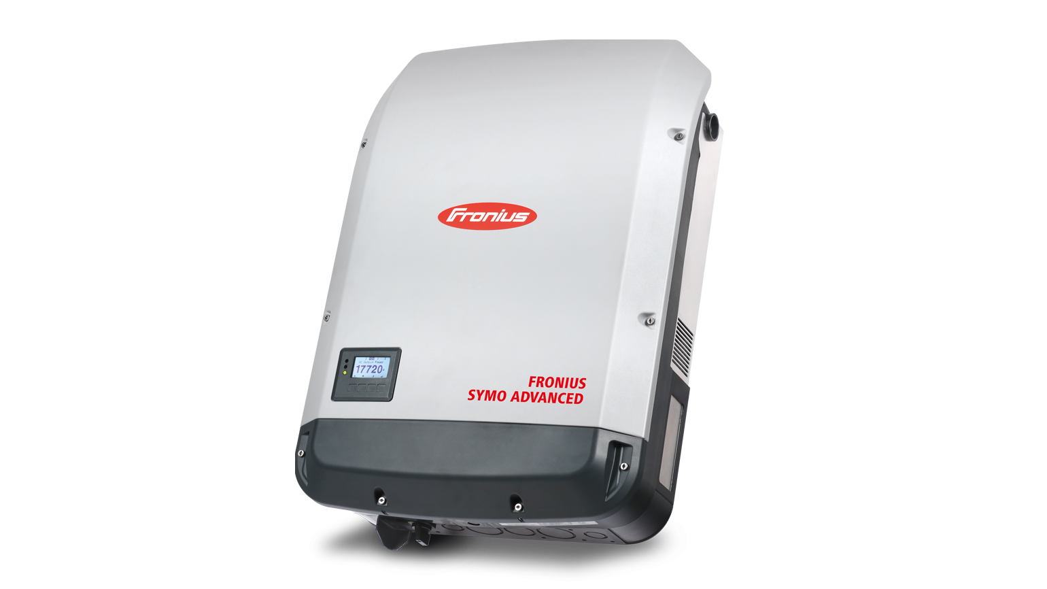
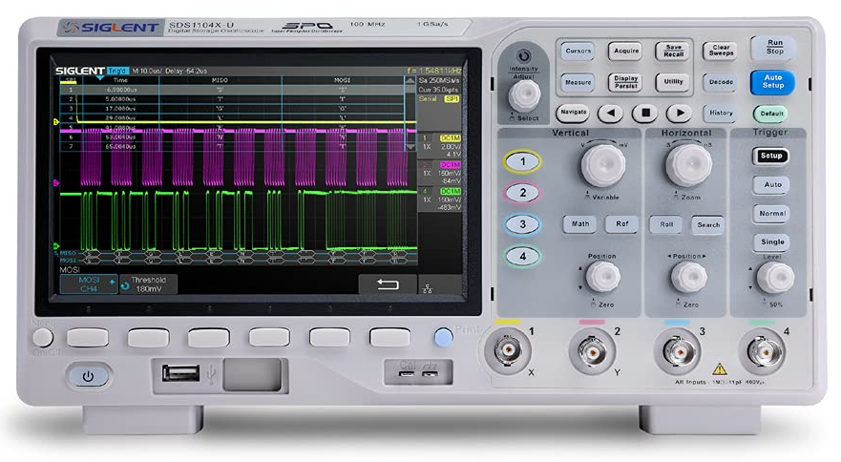
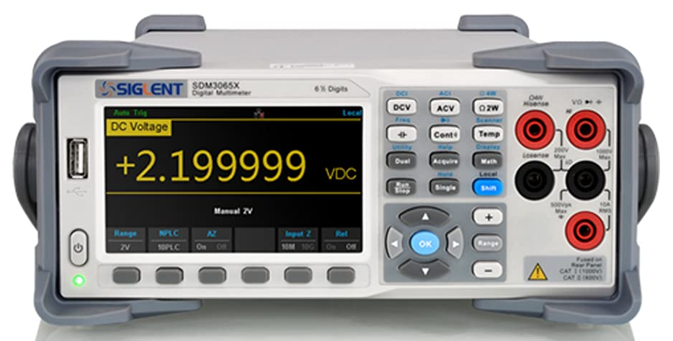
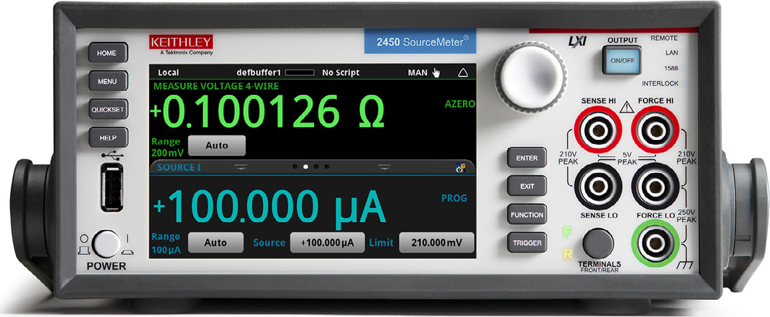
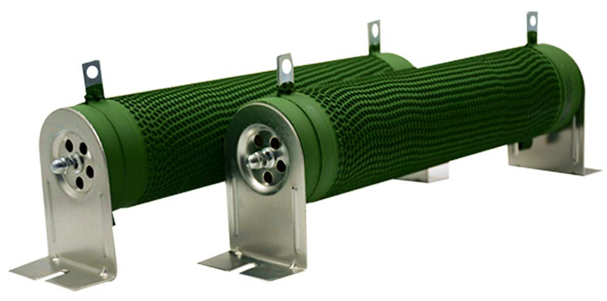
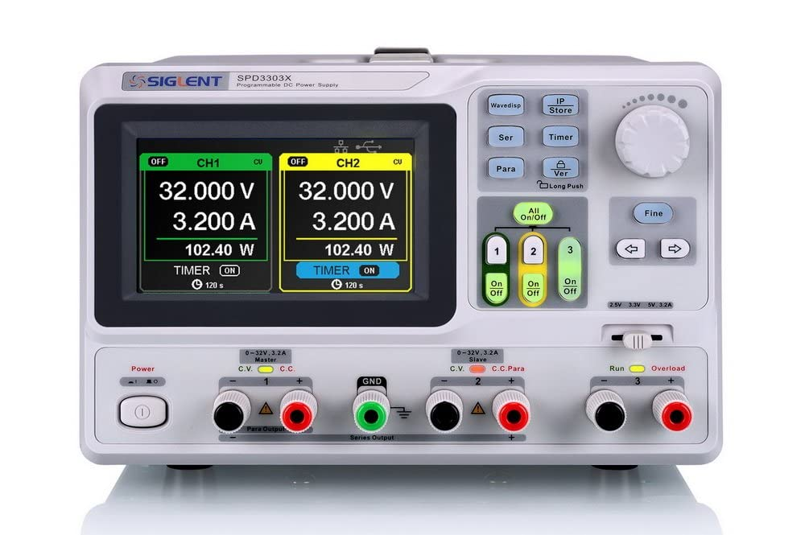
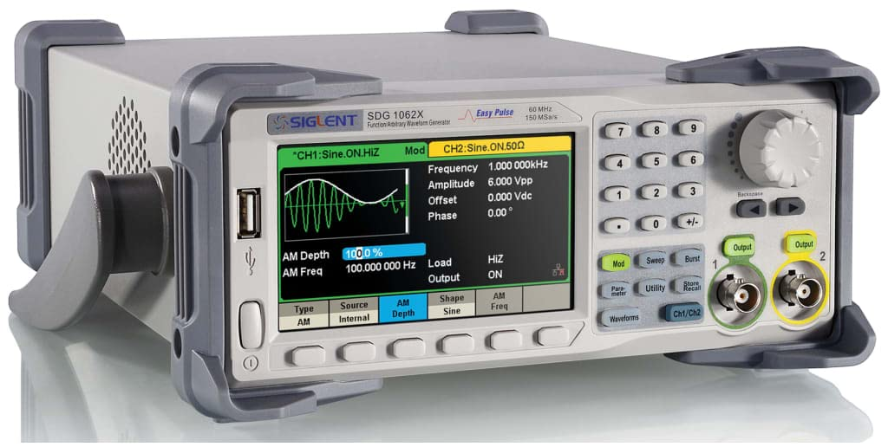
NHR 9410 Regenerative Grid Simulator 12kW (3 phases)
NHR 9430 AC Regenerative Load 12kW (3 phases)
ITECH Bidirectional DC Power Supply 300V/120A/12kW
NHR 4760 DC Electronic Loads 600V, 6kW
Fronius Symo Advanced 208-240V 3-Phase Inverter 10kW
Keithley High-Precision Sourcemeter
Digital Oscilloscopes
Digital Multimeters
Digital DC Power Supply
High-Power Resistive Load Bank
Digital Function Generator

Slide 3
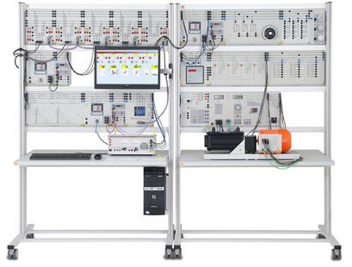
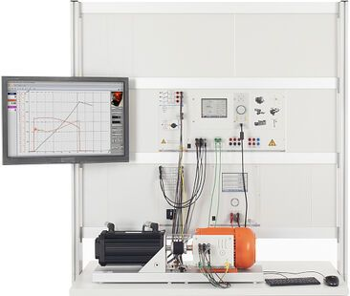
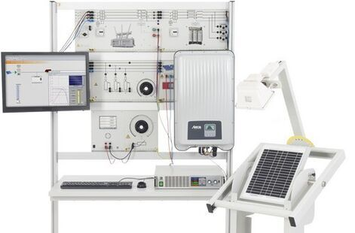
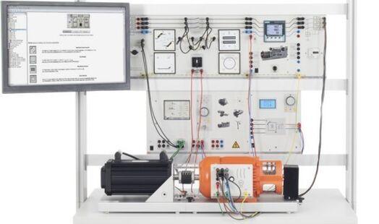
Lucas-Nuelle: ESG1 Smart Grid Trainer
Lucas-Nuelle: EUC Energy Management
Lucas-Nuelle: EPH Professional Photovoltaics Trainer
Lucas-Nuelle: EUG1 Manually Operated Synchronous Circuits
Lucas-Nuelle power grid training systems

Slide 4
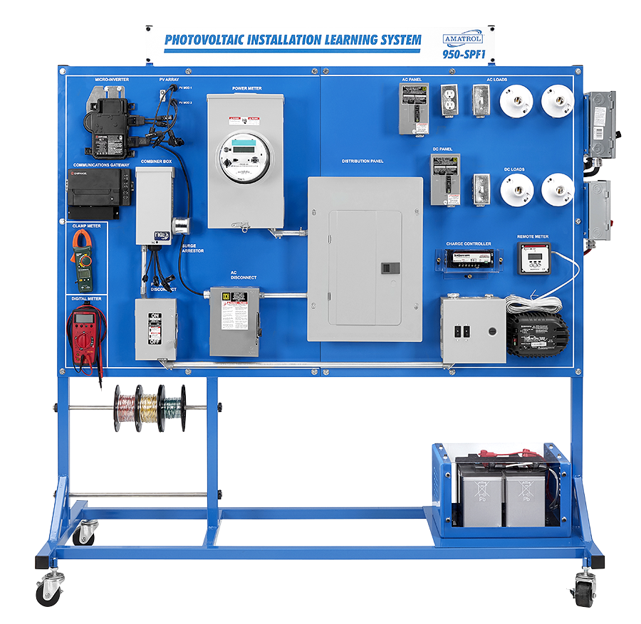
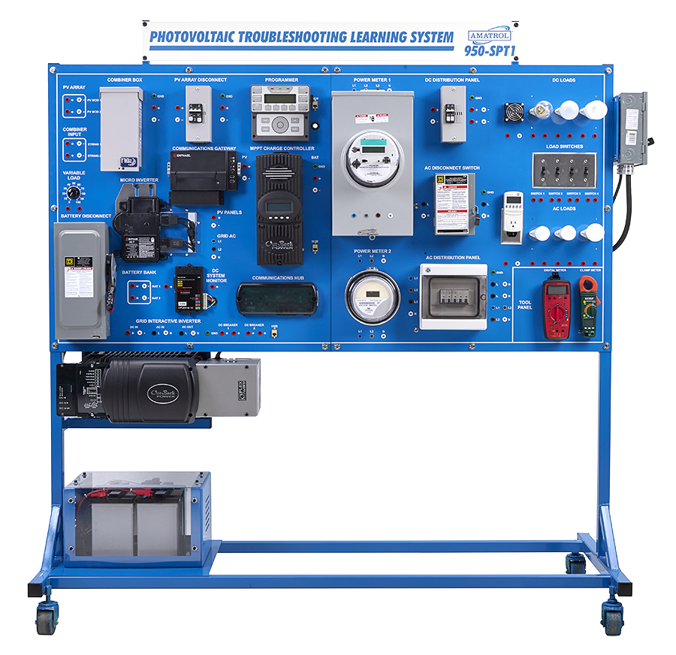
Amatrol Photovoltaic Installation Learning System 950-SPF1
Amatrol Photovoltaic Troubleshooting Learning System 950-SPT1

